Slide 1
ENSE 470 - Milestone 5
Group Name: GLHF
Group Members:
Vincent Chan
Thiago De Melo
Shuaihao Zhao
Joe Emmanuel Samano
March 15, 2018

Slide 2
Acceptance Test-Driven Development

Slide 3
User focus: Software Requester/ Software Approver/ Software Analyst
User story theme:
As a user, I would like to have an account to sign in, so I can track my software requests easier.
Acceptance test-driven development criteria (ATDD) (positive/negative) | Failed | Passed
[Positive] Given the user is currently in the login page, when s/he tries to log into his/her account with the correct password and username, then s/he will see the list of previous software requests. | *
[Negative] Given the user is currently in the login page, when s/he tries to log into his/her account with the incorrect password and username, then s/he will stay in the same page with a pop up indicating the message about the wrong operation and text input box will be highlighted red. | *

Slide 4
User focus: Software Requester
User story theme:
As a user, I would like to have a main webpage showing my request so I can find the status of my previous requests
Acceptance test-driven development criteria (ATDD) (positive/negative) | Failed | Passed
[Positive] Given the user is inside his account, when s/he have already submitted some requests, then s/he will notice that there will exist a table that shows the status of these requests. | *
[Positive] Given the user is inside his account and is viewing the list of requests, when s/he types a value in the filter box, then s/he will see only a list of request that matches the filter.

Slide 5
User focus: Software Requester
User story theme:
As a user, I would like to make a software request to be able to use a particular software.
Acceptance test-driven development criteria (ATDD) (positive/negative) | Failed | Passed
[Positive] Given that the user is logged in and is filling a webform, when s/he tries to search a particular software name by either typing in the name of the software or using the drop down structure, then s/he will notice that the software name suggestion that s/he can click on to appear in the web form. | *
[Negative] Given the user is logged in and is filling a webform, when s/he tries to search the particular software name by typing the incorrect software name, then s/he will not see a software name suggestion. | *
[Positive] Given the user is logged in, is filling a webform, when s/he has selected on a particular software and searches for a particular approver, then s/he will notice that the list of approvers will reflect the selected software | *
[Positive] Given the user is logged in and is filling a webform, when s/he submits the webform, then the software will send the software approver an email to inform him about the new request | *

Slide 6
User focus: Software Requester
User story theme:
As a user, I prefer filling the application form with error checking function, so I may not miss some important information.
Acceptance test-driven development criteria (ATDD) (positive/negative) | Failed | Passed
[Negative] Given the user is fulfilling the web form application, when s/he tries to submit the web form with all field empty, then s/he will notice that pop up on the right top of the page contains the error message and the text input box will be highlighted red. | *
[Positive] Given the user is fulfilling the web form application, when s/he tries to submit the web form by only fulfilling the software name, then s/he will notice that a new page will pop up with the success message and the software request information will appear in the table of the main page. | *
[Positive] Given the user is fulfilling the web form application, when s/he tries to submit the web form by fulfilling all of the field, then s/he will notice that a new page will pop up with the success message and the software request information will appear in the table of the main page. | *

Slide 7
User focus: Software Analyst/Approver
User story theme:
As a software analyst/approver, I want to receive notifications via email so that I can easily monitor any software requests.
Acceptance test-driven development criteria (ATDD) (positive/negative) | Failed | Passed
[Positive] Given the software analyst/approver is logged in to his/her email, when he/she reviews his/her inbox, then he/she will see an email showing that there is a new software request. | *
[Positive] Given the software analyst/approver has clicked on the email notification, when he/she reviews the content of the email, then he/she will see a link that will directly bring him/her to a sign in page. | *

Slide 8
User focus: Software Approver/Analyst
User story theme:
As a software approver/analyst, I would like to approve software request digitally to conveniently approve these software requests in a swift manner
Acceptance test-driven development criteria (ATDD) (positive/negative) | Failed | Passed
[Positive] Given the software analyst/approver is signed in to his/her account, when he/she sees a list of requests and clicks on a request, then he/she will see a pop up showing the information about the request. | *
[Positive] Given the software approver/analyst is logged into the system and opened the prompt for a particular software request, when s/he select to either approve or deny the request, then s/he will see a confirmation message and then s/he will see a status change of the request. | *
[Positive] Given the software approver is logged into the system, when s/he changes the status of a software request, then the software will send an email to the IT analyst that the software request has been processed. | *
[Positive] Given the software analyst already chose to approve a request, when he/she confirms on the confirmation message, then an email notification will be sent to the requester containing the access to the software and the software analyst will be redirected to the page containing the list of software requests. | *
[Positive] Given the software analyst already chose to deny a request, when he/she confirms on the confirmation message, then an email notification will be sent to the requester a message showing declination of request and the software analyst will be redirected to the page containing the list of software requests. | *

Slide 9
“Daily” Scrum

Slide 10
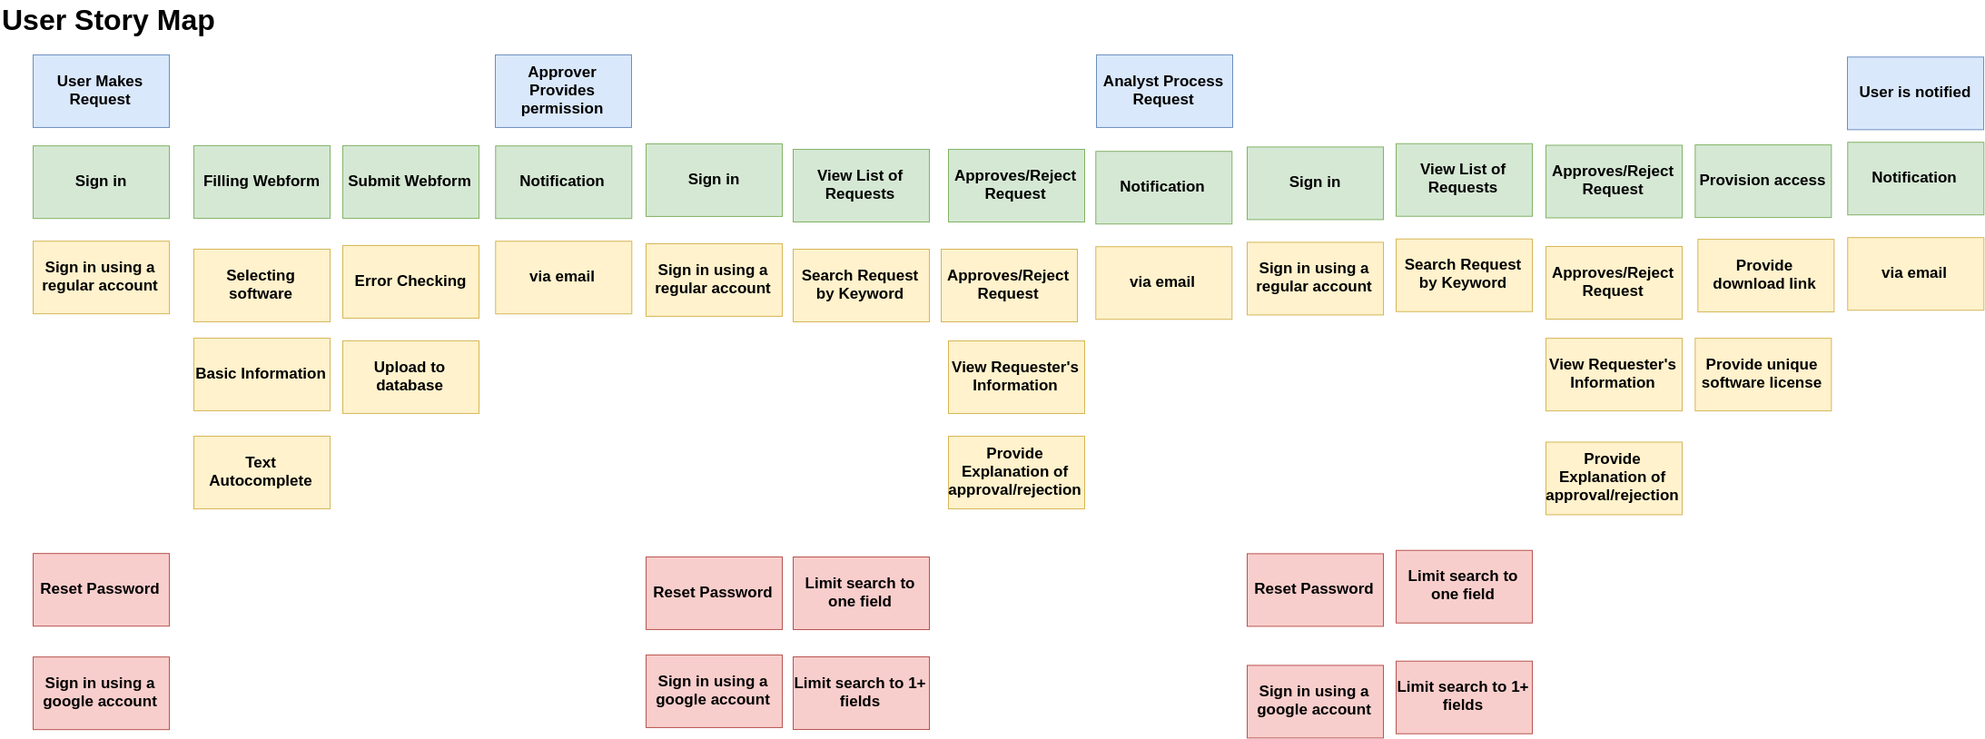
Release 1
Release 2
Legend
Done
Doing
TODO

Slide 11
Kanban Board
All
User
Approver
Analyst
Approver/Analyst
Product Backlog | To Do | In Progress | Testing | Completed
Reset Password
Email Notification
Filtering Feature
Sign in
Limit search to one or more fields
Provide Explanations
View List of Requests
Upload to database
Sign in using google accounts
Software Provision
View Requester’s Information
Filling Webform
Error Indicator
Error Checking
Text Autocomplete

Slide 12
Changes

Slide 13
Changes & Misc.
Added more error indication (red highlight)
Added Request History for Software Requester (User)
Changes the contents of webform
Removed Name
Added Optional fields which includes Email, Department, Software Approver, and Description
Added ways to reduce mistakes such as placing the approve and deny button away from each other and adding confirmation message.
Filtering feature

Slide 14
Group Reflection
How did you feel about this milestone? What did you like about it? What did you dislike?
It is a good way to keep track of progress and review on the stuff left to do.
ATDD provides more specific and detailed information compare to the user story.
ATDD is tedious but necessary.
What did you learn about yourself as you collaborated and worked through this milestone?
Communications improve the quality of the software design process a lot
First time we divided the work
A lot of overlapping work
Thiago is really good with coding.
How will you use what you have learned going forward?
Applying the use of test methods like ATDD in future projects.
What “stuff & things” related to this milestone would you want help with?
Nothing Much

